Slide 1
3D Image Segmentation and Quantification of Lysosomes
3/11/2025

Slide 2
3D Image Segmentation of Lysosomes
🧫 Identify and measure lysosomes
in 3D cell images.
📊 Quantify number, size, and localization
per cell.
🎯 Assign each lysosome to a cell
region.

Slide 3
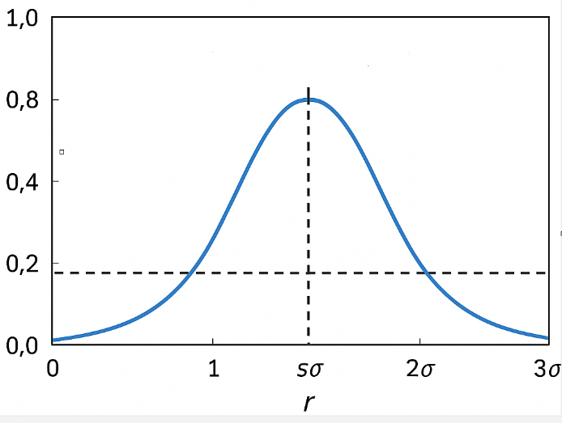
How it Measure Lysosome Size
1) Detect bright spots → potential lysosomes.
Spot detection converts brightness scale into 3D volume
2) Find best-fit scale (sigma) per spot.
3 ) Convert to radius: radius ≈ FACTOR × scale.
4) Calculate diameter and volume.
It is a factor comes from how spot detection algorithms in 3D microscopy (such as the Laplacian of Gaussian or Difference of Gaussians filters) relate the detected “scale” (σ) of a spot to its physical radius in voxel or micrometer units.
y-axis → intensity (I):
This is the normalized brightness of the image at that distance — how strong the fluorescence or light signal is.
Concept | Meaning
σ | The “spread” of the detected Gaussian spot.
FACTOR × σ | Physical radius of the lysosome (approximate optical boundary)
For example: FACTOR = 1.7 Radius = 1.7σ | Corresponds to ~20% of the max intensity.
x-axis → distance (r):
This represents how far a point is from the lysosome’s center in the image — measured in micrometers.
r=0: the lysosome center (brightest point), r=1σ,2σ,3σ: progressively farther from the center

Slide 4
How it Find the Cells
🔍 Meijering neuriteness filter :
Highlights neurite-like structures.
It can be used to detect continuous ridges,
e.g. neurites, wrinkles, rivers.
https://scikit-image.org/docs/0.25.x/api/skimage.filters.html#skimage.filters.meijering
⚙Local thresholding: adapts
to brightness variation.
🧹 Cleanup: remove noise and
fill gaps for continuous cells.

Slide 5
Topographic Map: Watershed Segmentation
🏔 Bright regions = hills (cell bodies), dark = valleys (background).
💧 Flood from each cell center until borders meet.
📍 Each pixel assigned to one cell → lysosomes labeled by cell ID

Slide 6
Summary
✨ Pipeline overview: spot detection → cell segmentation
→ labeling.
📈 Extract metrics: lysosome count, size, and spatial distribution.
💡 Visualization-ready for 3D cell analysis and comparison.

Slide 7
FILES
Airy scan_40A_UAS-TMEM-HA_CB_0h_1_051222
Airy scan_40A_UAS-TMEM-HA_CB_0h_2_051222
Airy scan_40A_UAS-TMEM-HA_CB_4h_1_051222
Airy scan_40A_UAS-TMEM-HA_CB_4h_2_051222
40A_UAS-TMEM192-3xHA x 40A 71G10 MARCM_around 12h - for quantification_4 Airy-CBs_300425
40A_UAS-TMEM192-3xHA x 40A 71G10 MARCM_around 12h - for quantification_3 Airy-CBs_300425
40A_UAS-TMEM1923x-HA x 71G10 40A MARCM_L3_2_Airy_010724
40A_UAS-TMEM1923x-HA x 71G10 40A MARCM_L3_1_Airy_010724

Slide 8
Airy scan_40A_UAS-TMEM-HA_CB_0h_1_051222

Slide 9
Airy scan_40A_UAS-TMEM-HA_CB_0h_1_051222

Slide 10
Airy scan_40A_UAS-TMEM-HA_CB_0h_2_051222

Slide 11
Airy scan_40A_UAS-TMEM-HA_CB_0h_2_051222

Slide 12
Airy scan_40A_UAS-TMEM-HA_CB_4h_1_051222

Slide 13
Airy scan_40A_UAS-TMEM-HA_CB_4h_1_051222

Slide 14
Airy scan_40A_UAS-TMEM-HA_CB_4h_2_051222

Slide 15
Airy scan_40A_UAS-TMEM-HA_CB_4h_2_051222

Slide 16
40A_UAS-TMEM192-3xHA x 40A 71G10 MARCM_around 12h - for quantification_4 Airy-CBs_300425

Slide 17
40A_UAS-TMEM192-3xHA x 40A 71G10 MARCM_around 12h - for quantification_4 Airy-CBs_300425

Slide 18
40A_UAS-TMEM192-3xHA x 40A 71G10 MARCM_around 12h - for quantification_3 Airy-CBs_300425

Slide 19
40A_UAS-TMEM192-3xHA x 40A 71G10 MARCM_around 12h - for quantification_3 Airy-CBs_300425

Slide 20
40A_UAS-TMEM1923x-HA x 71G10 40A MARCM_L3_2_Airy_010724

Slide 21
40A_UAS-TMEM1923x-HA x 71G10 40A MARCM_L3_2_Airy_010724

Slide 22
40A_UAS-TMEM1923x-HA x 71G10 40A MARCM_L3_1_Airy_010724

Slide 23
40A_UAS-TMEM1923x-HA x 71G10 40A MARCM_L3_1_Airy_010724

